Slide 1
Ranking Based Question Answering System

Slide 2
Agenda
Introduction
Related Work
Proposed Technique and Algorithm
Implementation
Work Update

Slide 3
Introduction
Question Answering system is an automated computer system that answers queries questioned by humans in natural language.

Slide 4
Related Work
Many user based question answering systems available on the web:
Quora
Stack Overflow
Stack Exchange
Yahoo Answers
Flutter

Slide 5
Proposed Technique
The architecture of the system comprises of 4 modules:
Chrome/Firefox Extension
Question Selection Web Service
Question Answering System
Question Classification Model

Slide 6
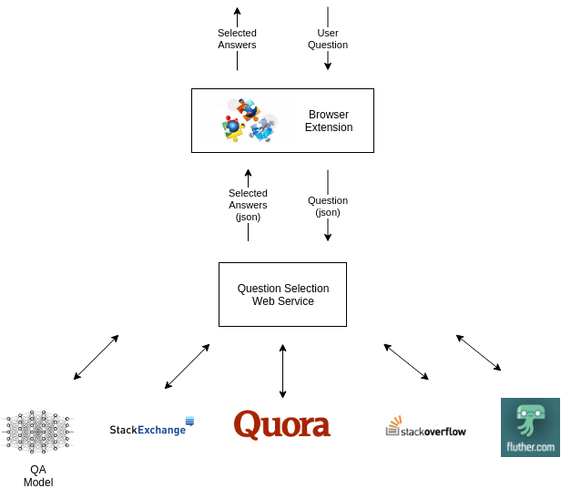

Slide 7
Dataset
The Yahoo! Answers topic classification dataset is a human labelled dataset constructed using 10 largest main categories.
Each class contains 140,000 training samples and 6,000 testing samples. Therefore, the total number of training samples is 1,400,000 and testing samples 60,000 in this dataset.
From all the answers and other meta-information, only the best answer content and the main category information were used.

Slide 8
Classes for classification
Society & Culture
Science & Mathematics
Health
Education & Reference
Computers & Internet

Slide 9
Classes for classification (Contd.)
6. Sports
7. Business & Finance
8. Entertainment & Music
9. Family & Relationships
10. Politics & Government

Slide 10
Implementation Details
Tokenization
Stop words removal
Lemmatizing with NLTK
Measuring the Cosine Similarity

Slide 11
Question Classification - Approach
Text Exploration
Text Cleaning
Obtaining POS Tags, Identifying Named Entities, Lemmas, Syntactic Dependency Relations and Orthographic Features.
Using the obtained properties as Features.
Using a Linear SVM model on the engineered features.

Slide 12
Model
Linear Support Vector Machine Classifier
Features used: Named Entity Recognition + Lemmas + POS Tags
Accuracy: 66.316%

Slide 13
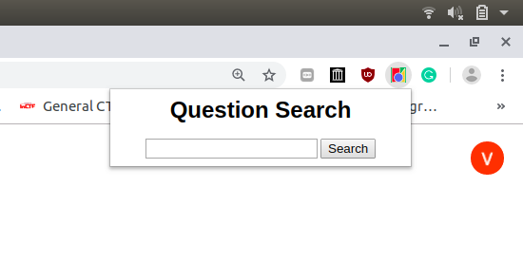
Implementation

Slide 14
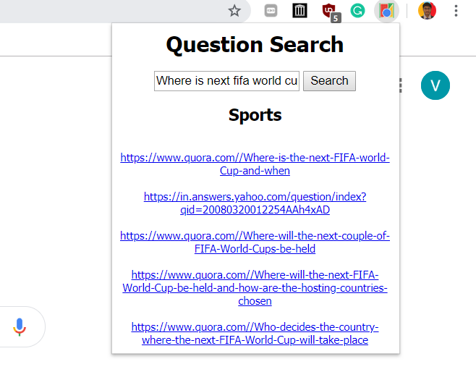

Slide 15
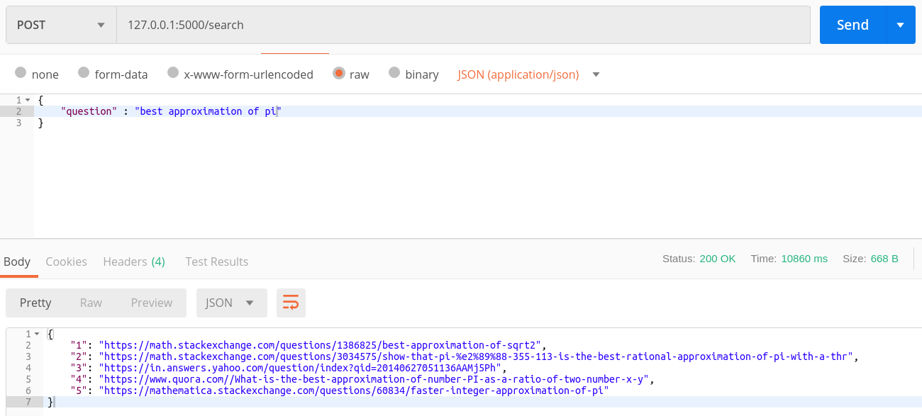

Slide 16
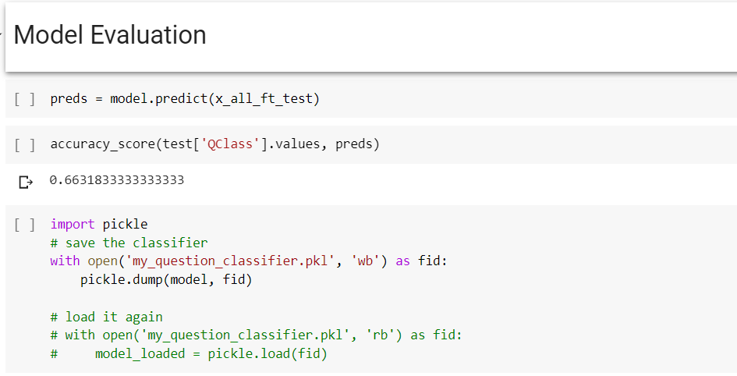
Accuracy

Slide 17
Work Update
Developed Chrome Web Extension
Developed Question Selection Web Service
Selected most relevant Questions from QA systems using the developed web service.
Question similarity matching using cosine similarity
Applied Classification techniques to find the domain of the asked question
Deployed and integrated context-based QA model of BITS Pilani with the above-developed system

Slide 18
Future Goals
Integrating deep learning techniques such as Siamese Manhattan LSTM for similarity matching of questions. The model has been prepared but requires more improvement in accuracy.

Slide 19
THANK YOU
Vishal Mittal (2017A7PS0080P)
Kamaldeep Verma (2018H1120281P)

